Slide 1
Machine Learning

Slide 2
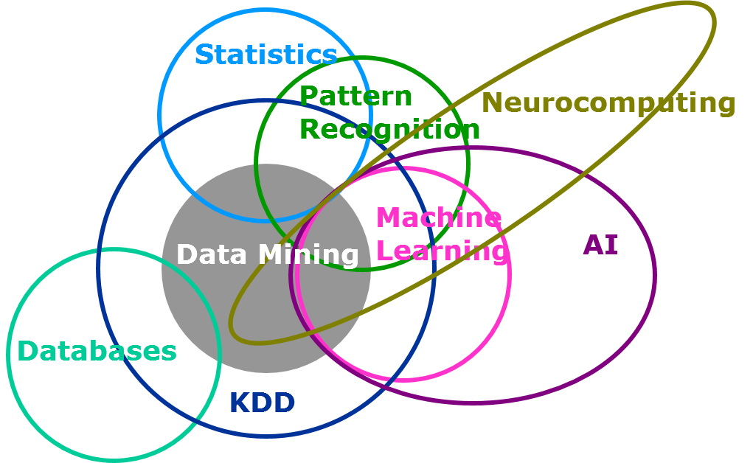
Data Mining
Data mining is the application of the methods of statistics, data analysis, and machine learning to the exploration and analysis of large data sets, with the aim of extracting new and useful information that will benefit the owner of these data.

Slide 3
Difference between Machine Learning and Statistical Modeling
Machine Learning is …
an algorithm that can learn from data without relying on rules-based programming.
Statistical Modeling is …
formalization of relationships between variables in the form of mathematical equations.
Machine Learning algorithms are wide range tools. Online Learning tools predict data on the fly. These tools are capable of learning from trillions of observations one by one. They make prediction and learn simultaneously. Machine learning does really well with wide (high number of attributes) and deep (high number of observations).
However Statistical Modelling are generally applied for smaller data with less attributes or they end up over fitting.

Slide 4
So What Is Machine Learning?
Tom Mitchell’s Machine Learning Definition
A computer program is said to learn from experience E with respect to some class of tasks T and performance measure P, if its performance at tasks in T, as measured by P, improves with experience E.
Automating automation
Getting computers to program themselves
Writing software is the bottleneck
Let the data do the work instead!

Slide 5
Machine Learning…….
Traditional Programming
Data
Computer
Output
Program
Machine Learning
Data
Computer
Program
Output

Slide 6
Why “Learn”?
Machine learning is programming computers to optimize a performance criterion using example data or past experience.
There is no need to “learn” to calculate payroll
Learning is used when:
Human expertise does not exist (navigating on Mars),
Humans are unable to explain their expertise (speech recognition)
Solution changes in time (routing on a computer network)
Solution needs to be adapted to particular cases (user biometrics)

Slide 7
What We Talk About When We Talk About “Learning”
Learning general models from a data of particular examples
Data is cheap and abundant (data warehouses, data marts); knowledge is expensive and scarce.
Example in retail: Customer transactions to consumer behavior:
People who bought “Da Vinci Code” also bought “The Five People You Meet in Heaven” (www.amazon.com)
Build a model that is a good and useful approximation to the data.

Slide 8
Algorithms
The success of machine learning system also depends on the algorithms.
The algorithms control the search to find and build the knowledge structures.
The learning algorithms should extract useful information from training examples.

Slide 9
Algorithms
Supervised learning
Prediction
Classification (discrete labels), Regression (real values)
Unsupervised learning
Clustering
Probability distribution estimation
Finding association (in features)
Dimension reduction
Semi-supervised learning
Reinforcement learning
Decision making (robot, chess machine)

Slide 10
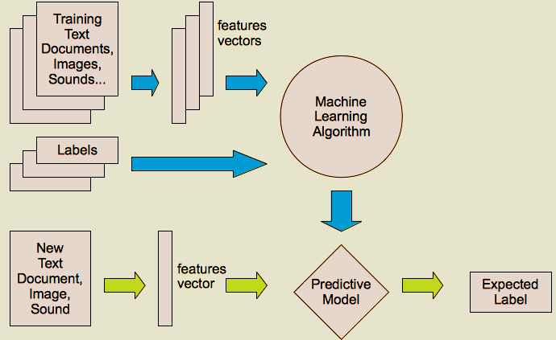
Supervised learning

Slide 11
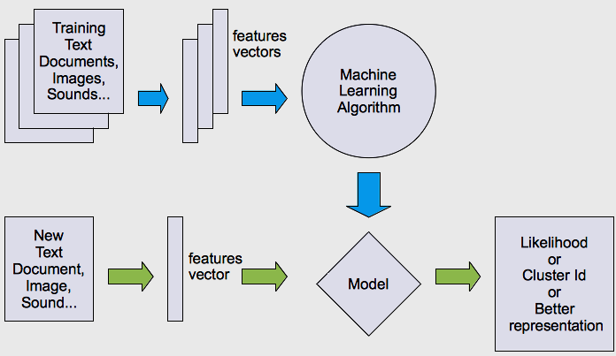
Unsupervised learning

Slide 12
Learning techniques
Supervised learning categories and techniques
Linear classifier (numerical functions)
Parametric (Probabilistic functions)
Naïve Bayes, Gaussian discriminant analysis (GDA), Hidden Markov models (HMM), Probabilistic graphical models , ….
Non-parametric (Instance-based functions)
K-nearest neighbors, Kernel regression, Kernel density estimation, Local regression, Artificial Neural Nwtwork ……,…
Non-metric (Symbolic functions)
Classification and regression tree (CART), decision tree
Aggregation
Bagging (bootstrap + aggregation), Adaboost, Random forest

Slide 13
Learning techniques
Unsupervised learning categories and techniques
Clustering
K-means clustering
Spectral clustering
Self Organizing Map
…
Density Estimation
Gaussian mixture model (GMM)
Graphical models
…
Dimensionality reduction
Principal component analysis (PCA)
Factor analysis
…

Slide 14
Machine Learning in Manufacturing
In manufacturing, it can support functions such as:
Automation: machine learning systems are not always given an embodied form, but they can be used in robotics, creating systems that can undertake complex tasks as part of production lines.
Optimisation: the analysis provided by machine learning systems can be used to optimise processes, products or prices, and increase productivity as a result.
Predictive maintenance: the patterns detected by machine learning systems can be used to predict which bits of equipment or installations are going to fail, before this failure occurs, so that maintenance efforts can be directed accordingly.
Personalisation: machine learning algorithms can analyse data about customers and their preferences, and use this to create personalised products.

Slide 15
Applications in Other Areas
Face detection
Object detection and recognition
Image segmentation
Multimedia event detection
Economical and commercial usage

Slide 16
Applications in Healthcare and Life science
Alerts and diagnostic from real-time patient data
Disease identification and risk stratification
Patient triage optimization
Proactive health management
Healthcare provider sentiment analysis
Medical imaging (Heart, Lung, Breast, Kidney)

